Slide 1
Echocardiographic Approach to Shock
Hypovolemic Shock &
Acute Heart Failure
Rasoul Azarfarin
Prof. of Anesthesiology MD, FACC
Rajaie Cardiovascular Medical & Rearch Center
Jan 18 2018

Slide 2
Definition of Shock
Inadequate oxygen delivery to meet metabolic demands
Results in global tissue hypoperfusion and metabolic acidosis
Shock can occur with a normal blood pressure and hypotension can occur without shock

Slide 3
Types of Shock
Hypovolemic
Septic
Cardiogenic
Anaphylactic
Neurogenic
Obstructive

Slide 4
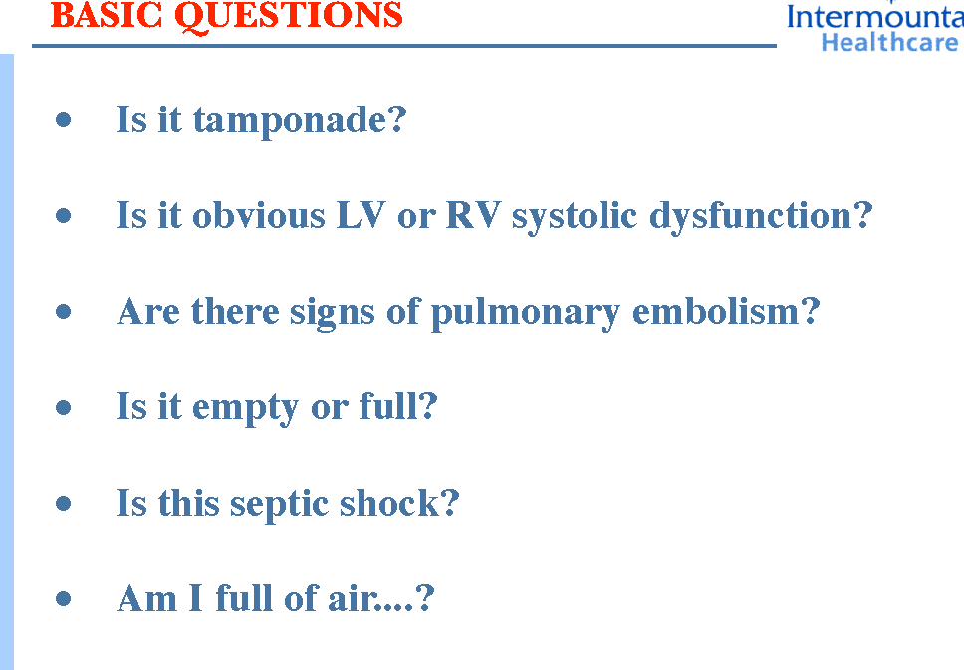

Slide 5
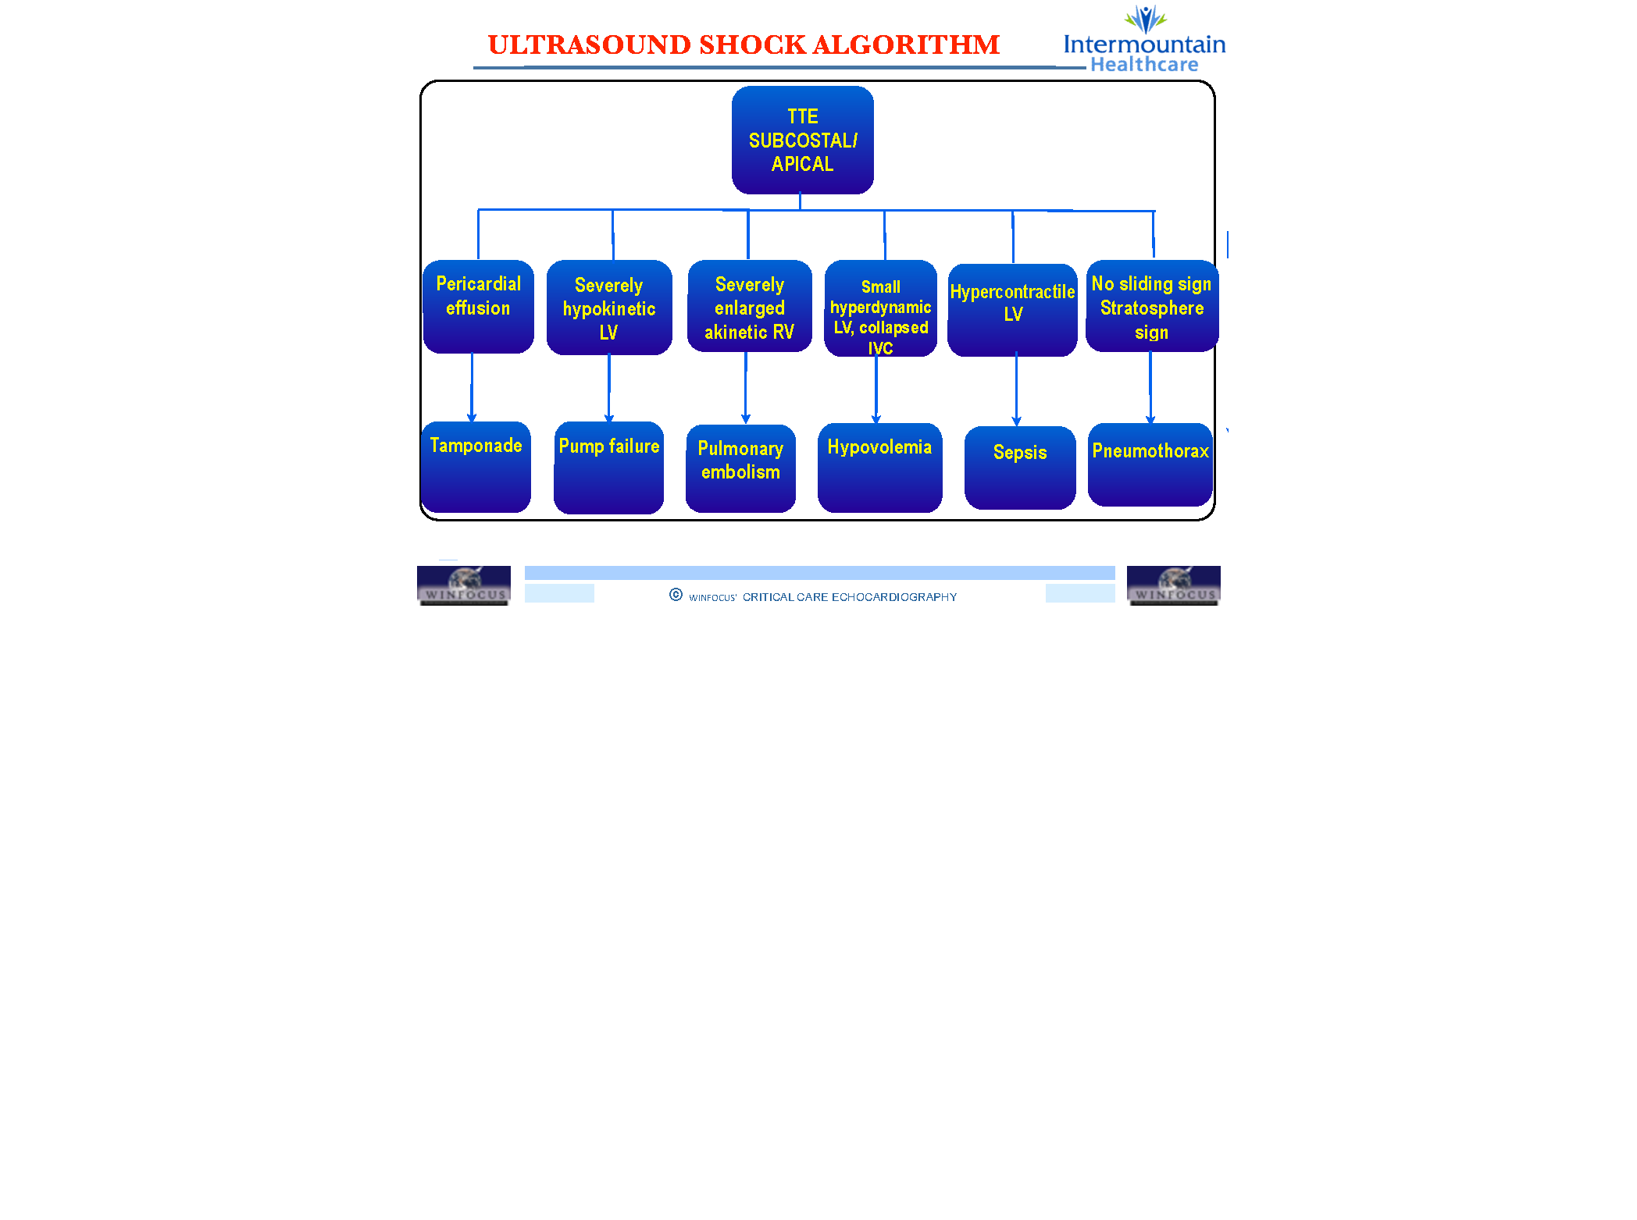

Slide 6
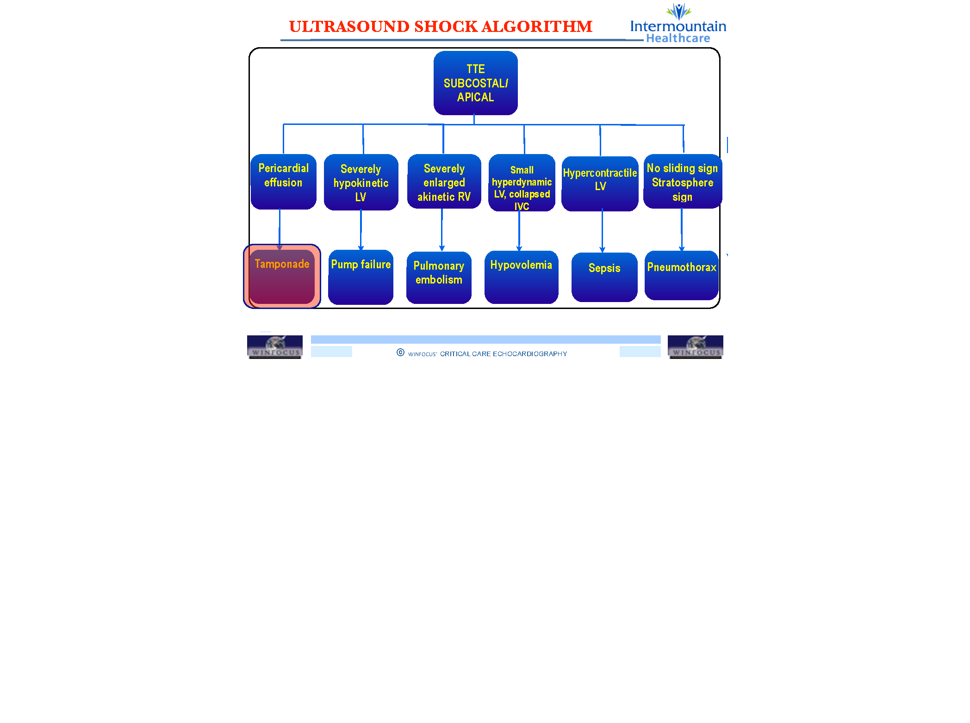

Slide 7
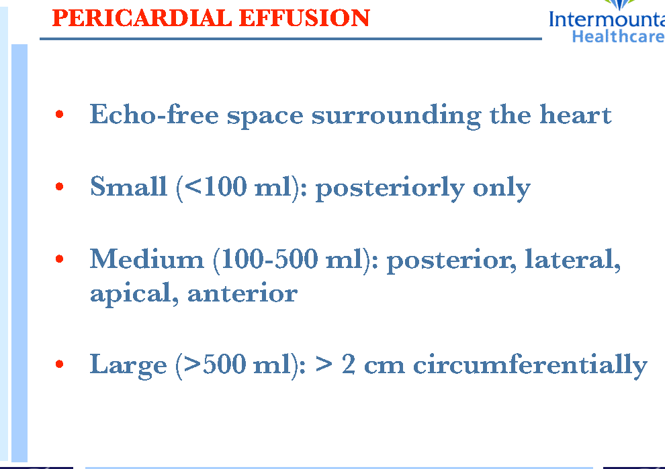

Slide 8
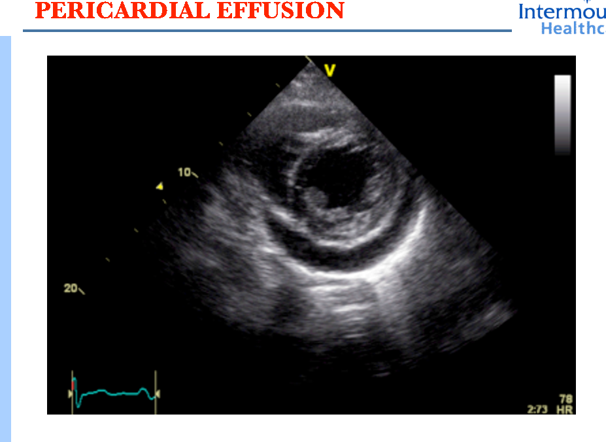

Slide 9
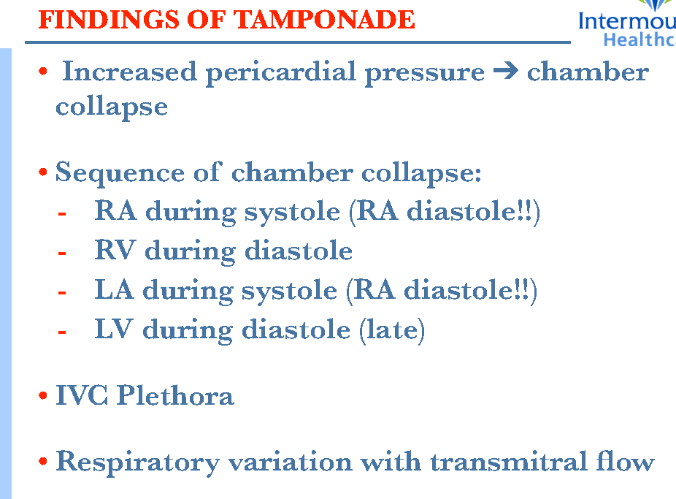

Slide 10
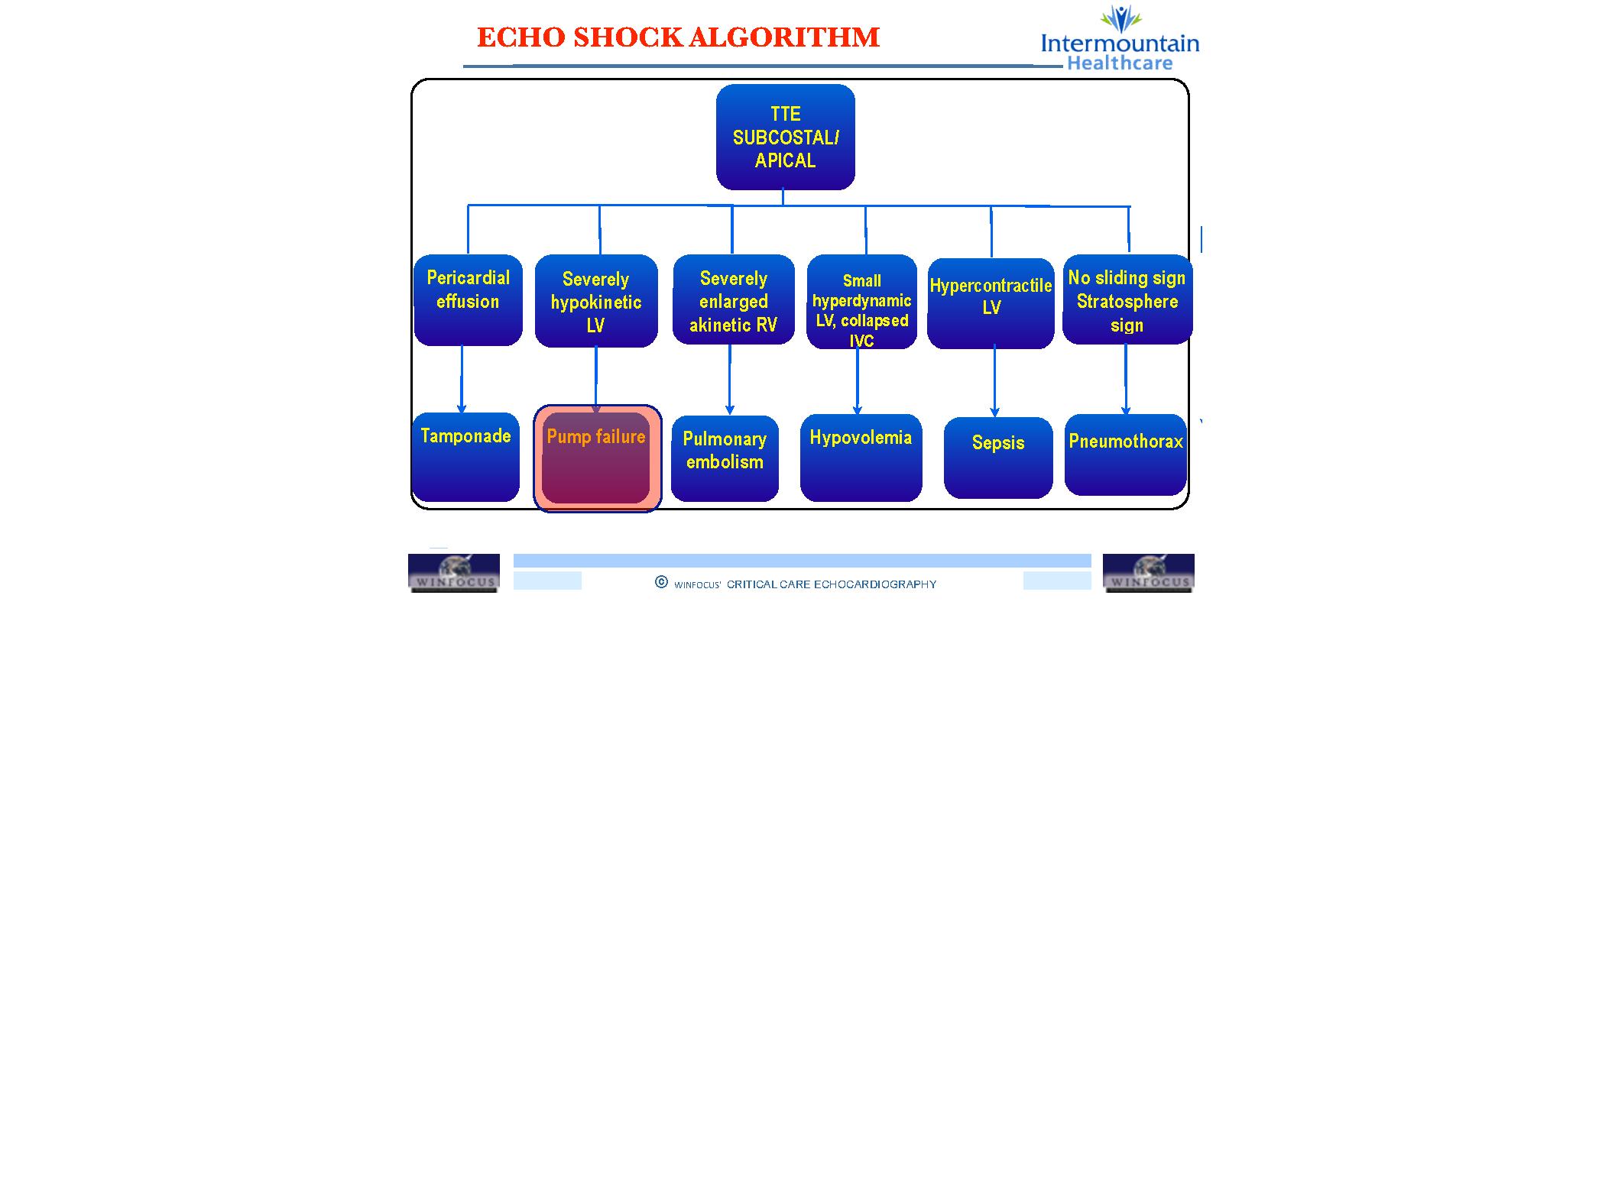

Slide 11
Cardiogenic Shock
Defined as:
  SBP < 90 mmHg
  CI < 2.2 L/m/m²
  PCWP > 18 mmHg
Signs:
  Cool, mottled skin
  Tachypnea
  Hypotension
  Altered mental status
  Narrowed pulse pressure
  Rales, murmur

Slide 12
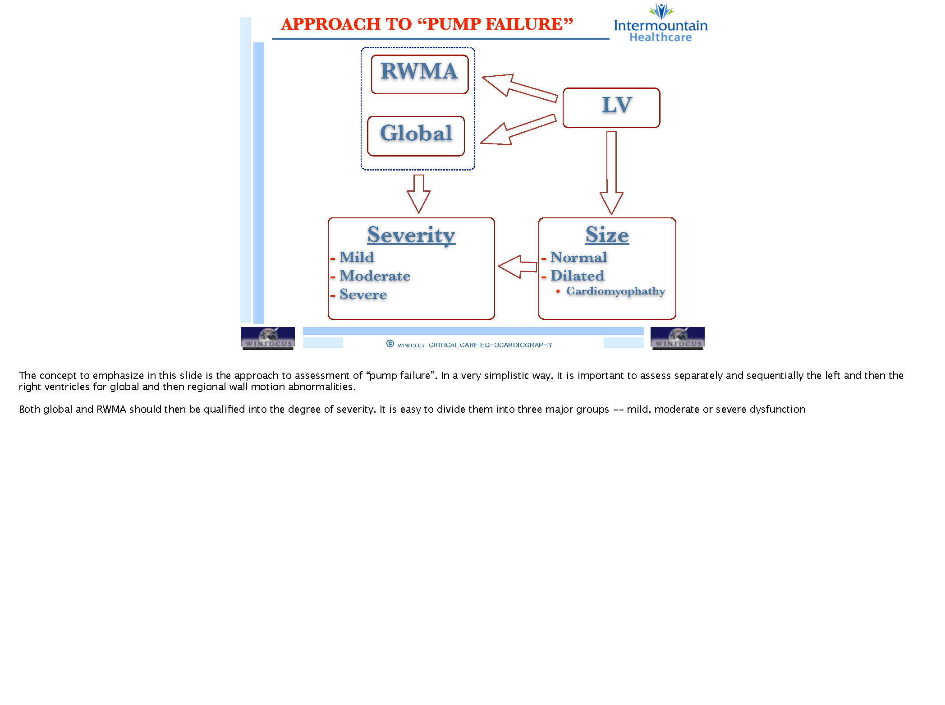

Slide 13
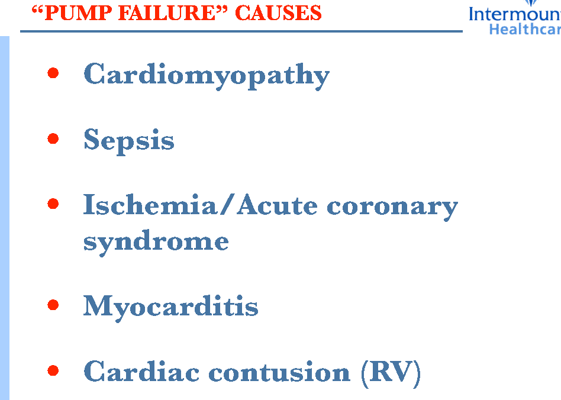

Slide 14
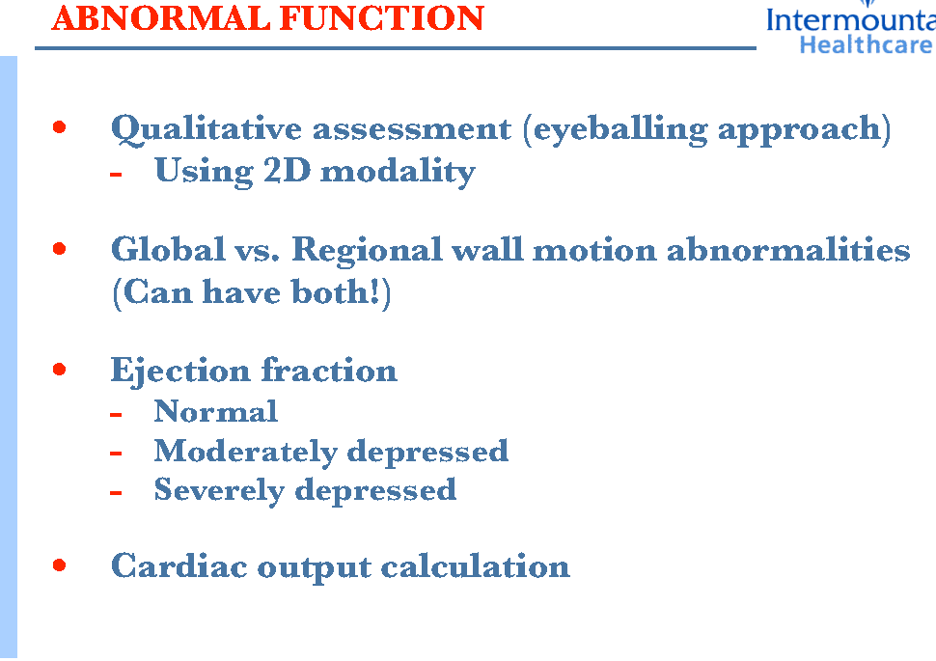

Slide 15
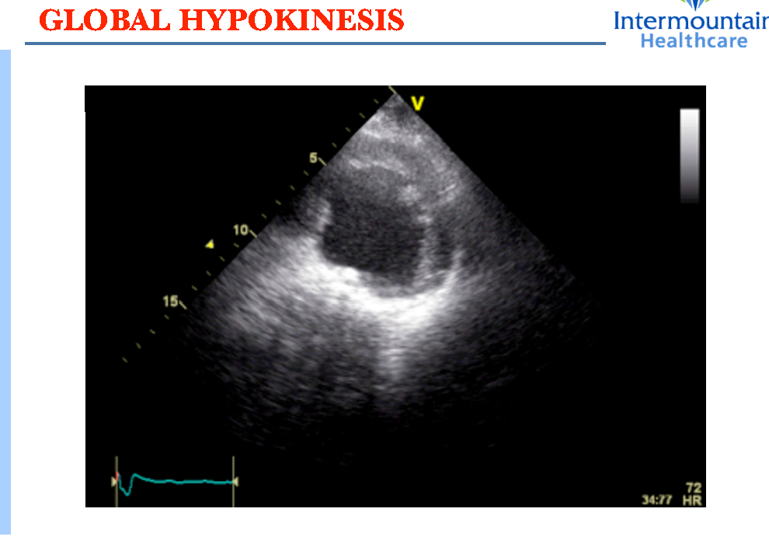

Slide 16
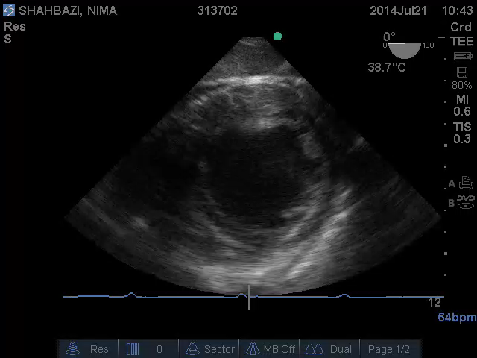
Global LV Dysfunction

Slide 17
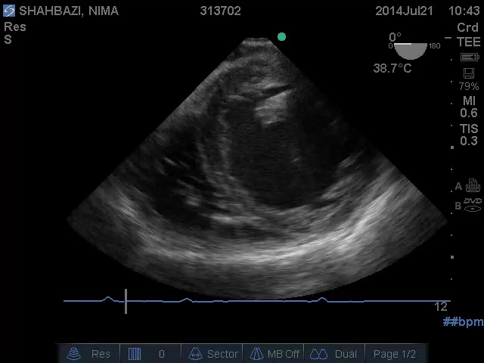
Global LV Dysfunction

Slide 18
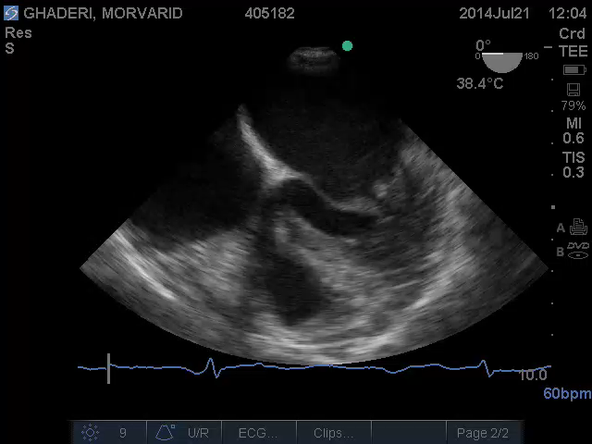
Global LV Dysfunction

Slide 19
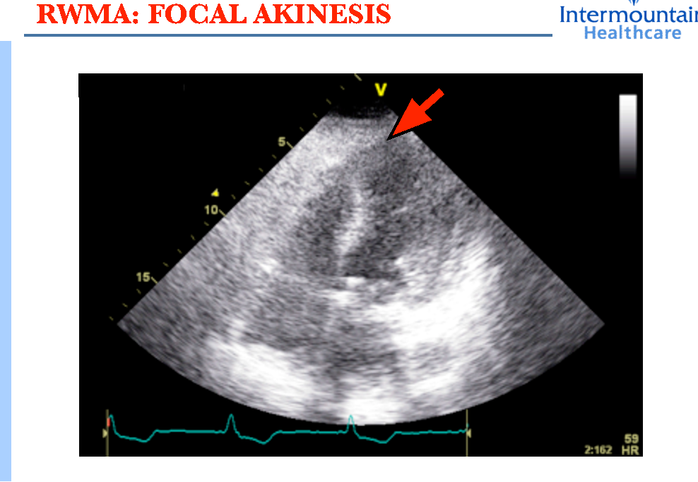

Slide 20
Step 3: Estimate LAP (High > 15 mmHg)
Diastolic dysfunction?
High LAP
Normal LAP
Low LAP
In general terms, the trend in PCWP is in the same direction as the change in inter-atrial septal pattern.

Slide 21
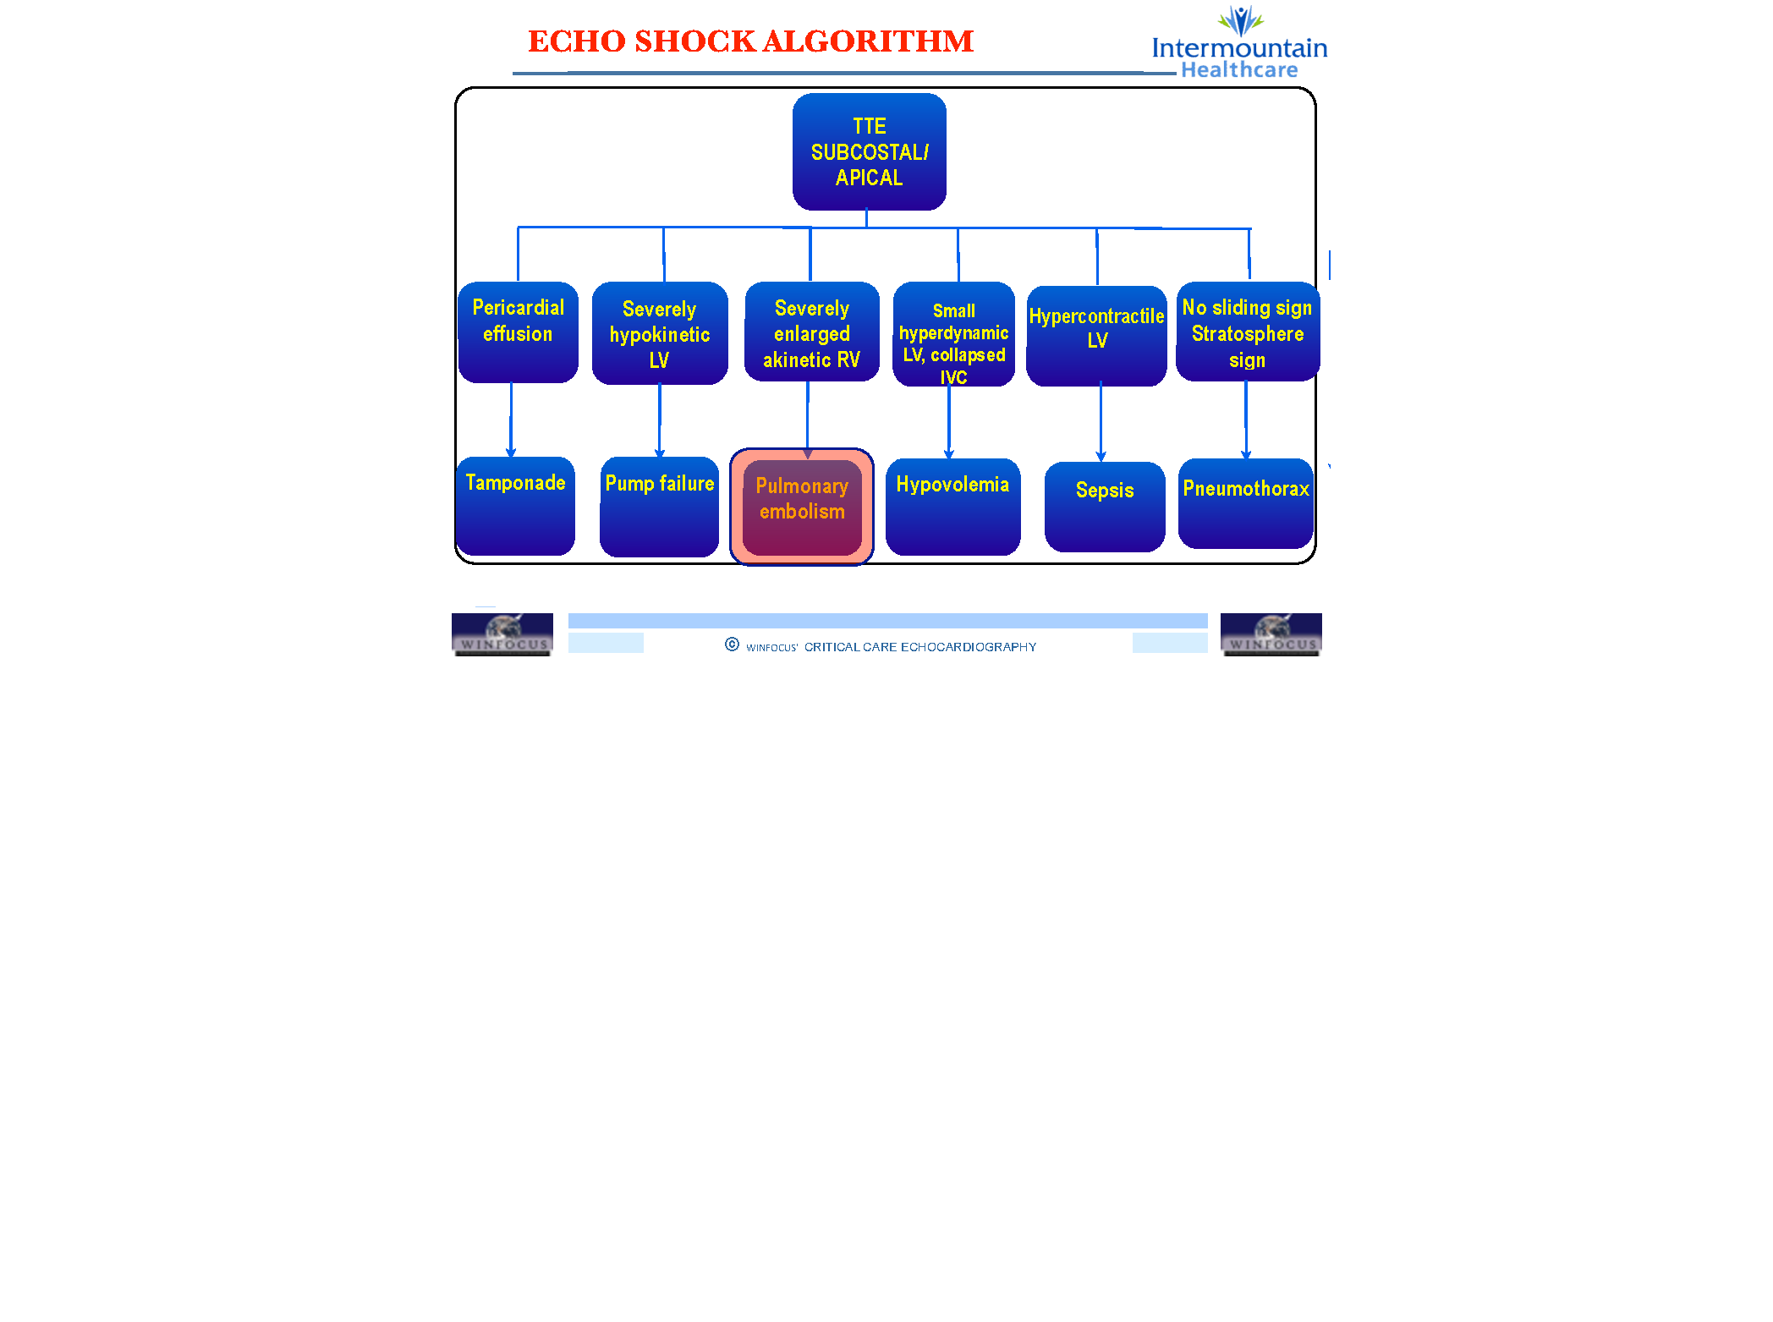

Slide 22
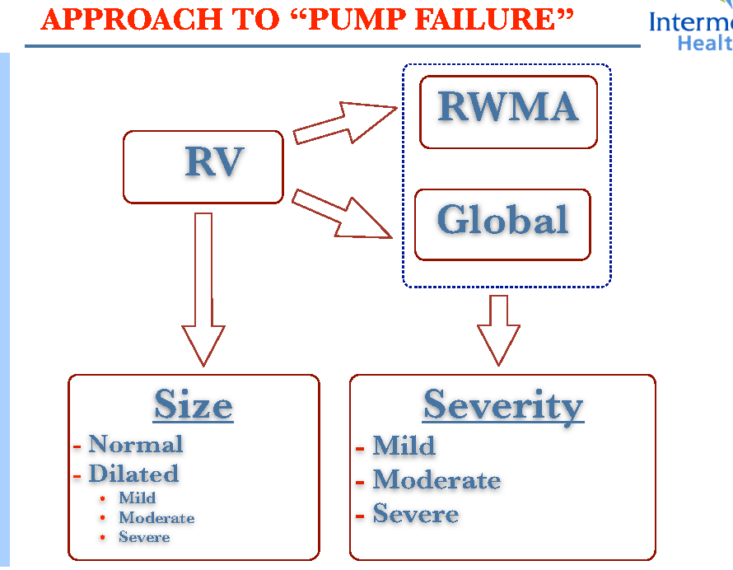

Slide 23
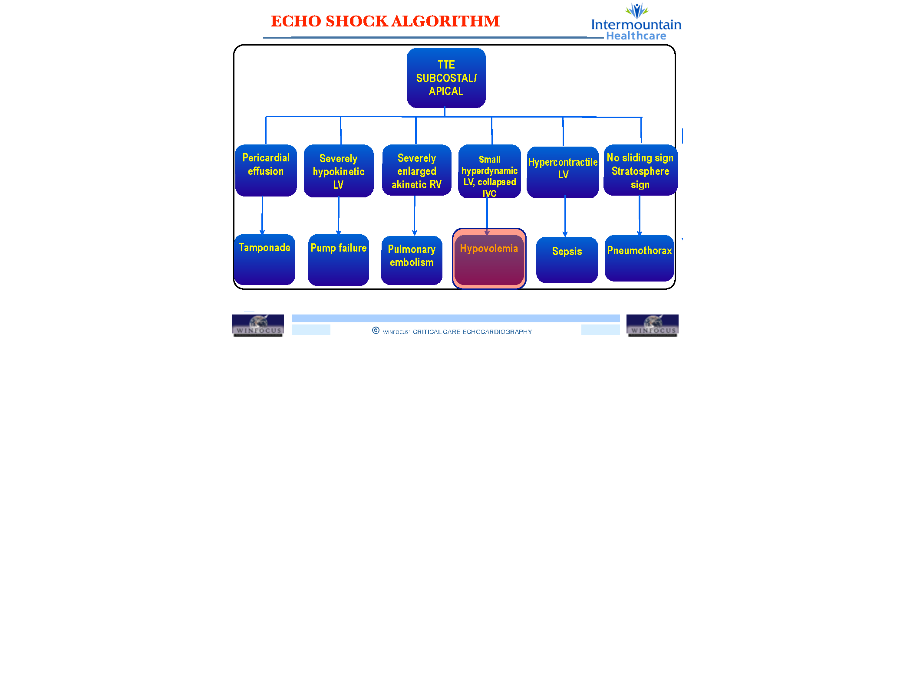

Slide 24
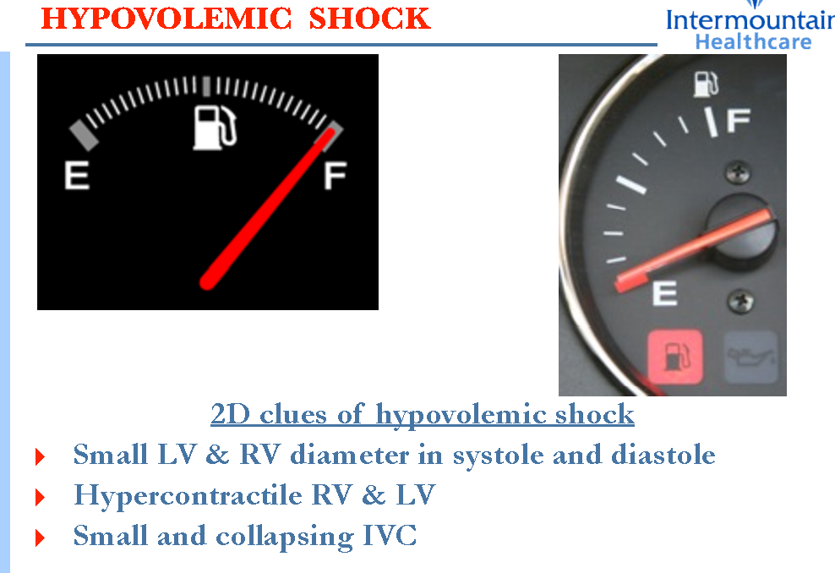

Slide 25
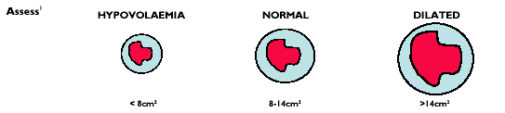
Step 1: Estimate Left Ventricular End Diastolic Volume (Preload) / LVEDA
normal range of LVEDA= 8-14 cm²
An LVEDA < 8 cm² is consistent with hypovolaemia, and
LVEDA > 14 cm², consistent with a dilated left ventricle

Slide 26
Step 2: Estimate Systolic Function
LVESA [FAC]
FAC= (EDA – ESA) / EDA
.Increased (FAC > 65%)
.Normal (FAC 50-65%)
.Reduced (<50%).

Slide 27
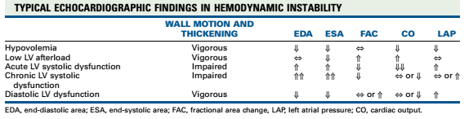
With low LV afterload cardiac index is usually
high (>3.5 L/min/m²), whereas with hypovolemia
cardiac index is usually low (<2.5 L/min/m²)

Slide 28
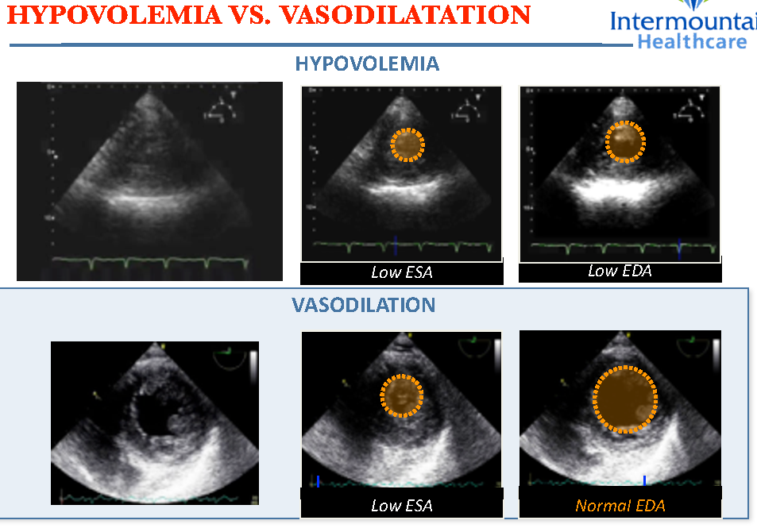

Slide 29
Semiquantative (Visual: eyeballing) method of assessing ventricular function
LV contraction is visualised in the entire standard transthoracic 2-D imaging planes:
PLAX & PSAX view
AP4Ch & AP2Ch view
Apical long axis (Aplax) view
subcostal long (Sublax) and short axis (Subsax) views
The grading of the global systolic contraction can be described as:
normal
reduced
severely reduced

Slide 30
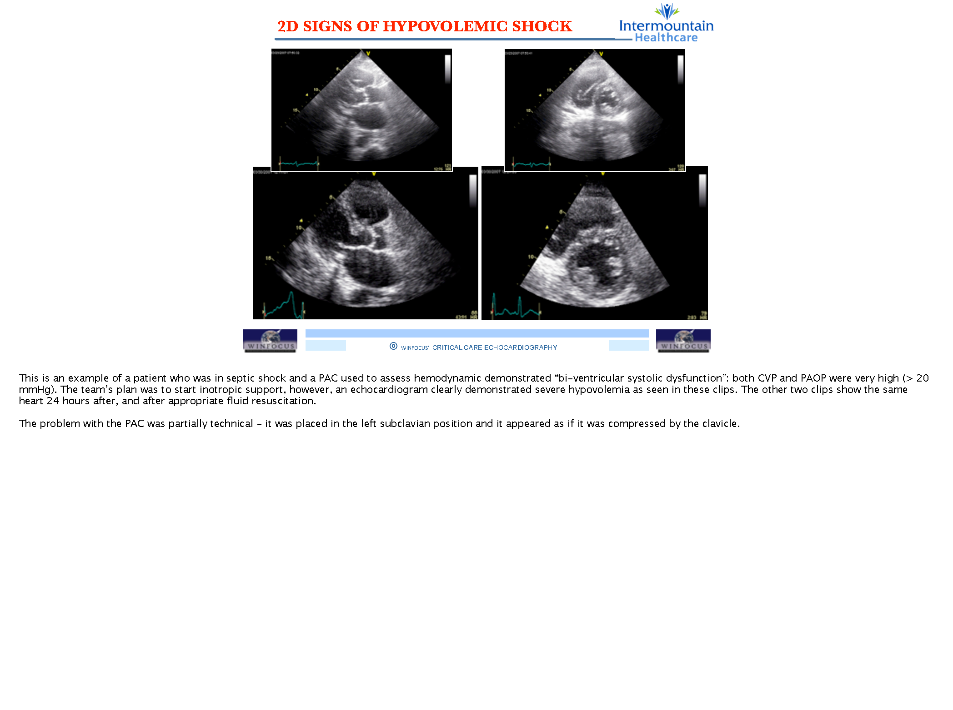

Slide 31
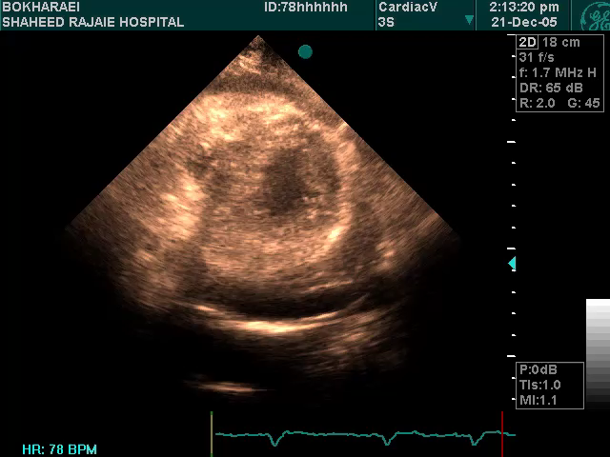
RV Rupture+ PE

Slide 32
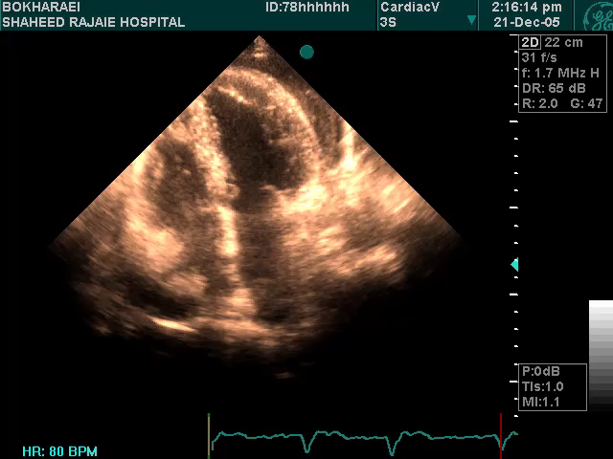
RV Rupture+ PE

Slide 33
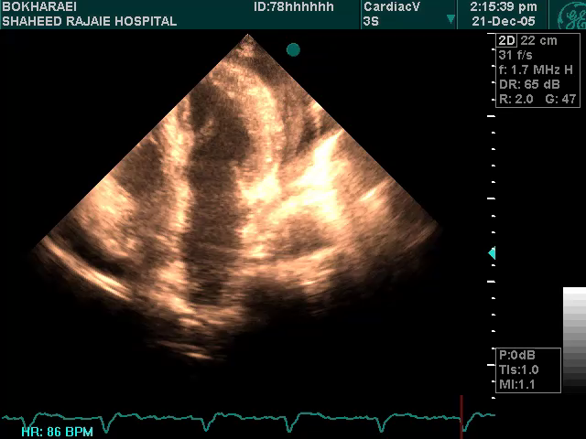
RV Rupture+ PE

Slide 34
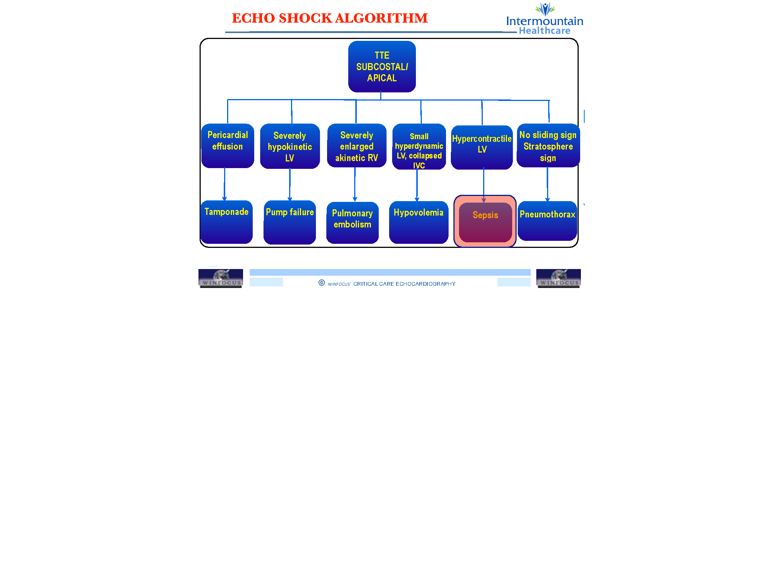

Slide 35
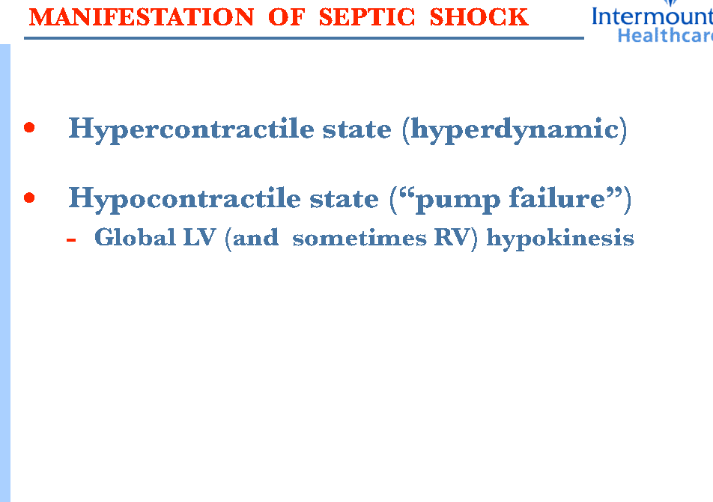

Slide 36
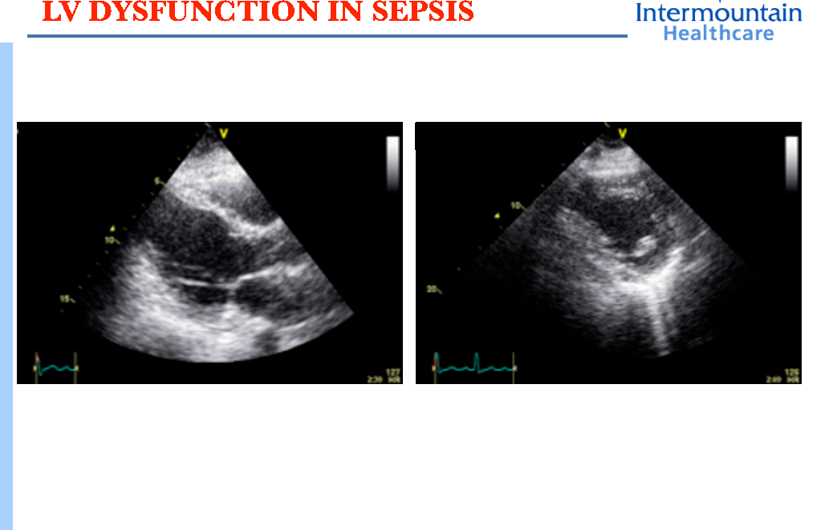

Slide 37
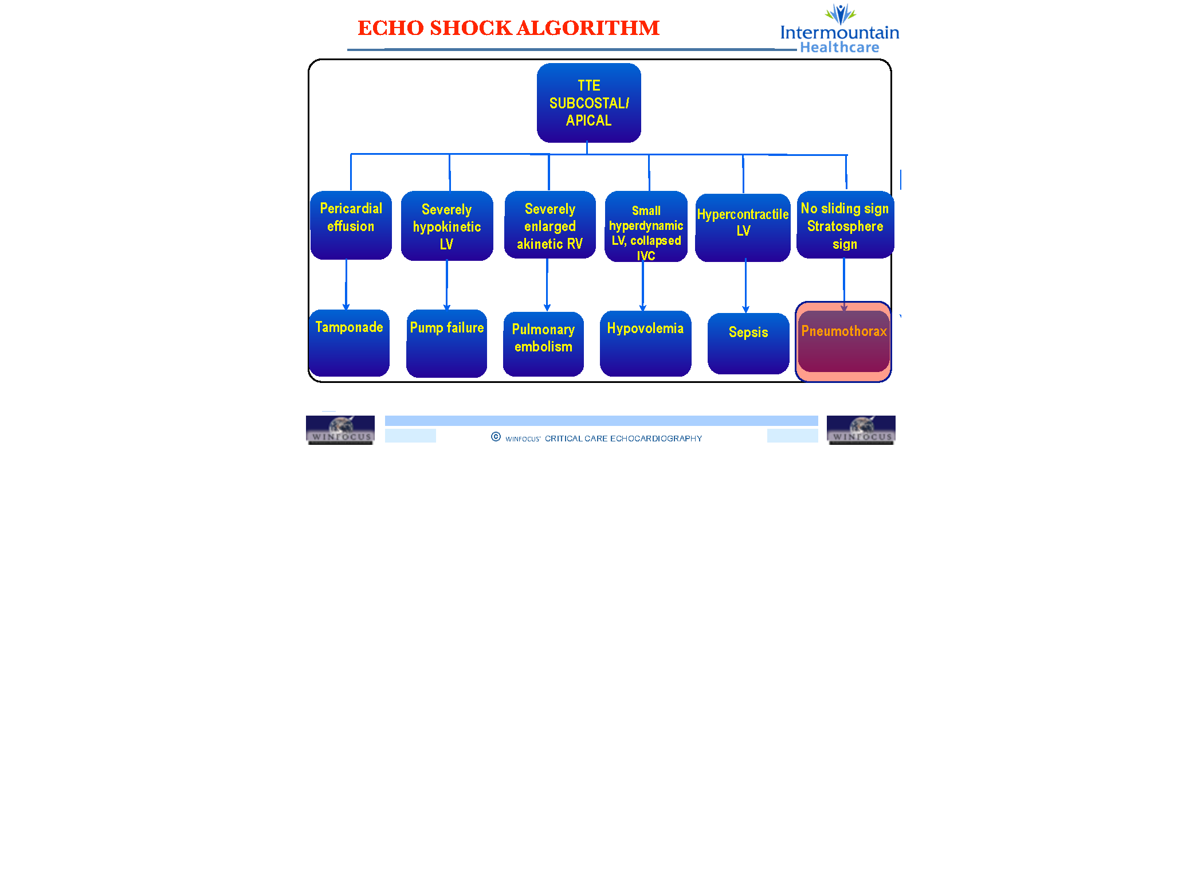

Slide 38
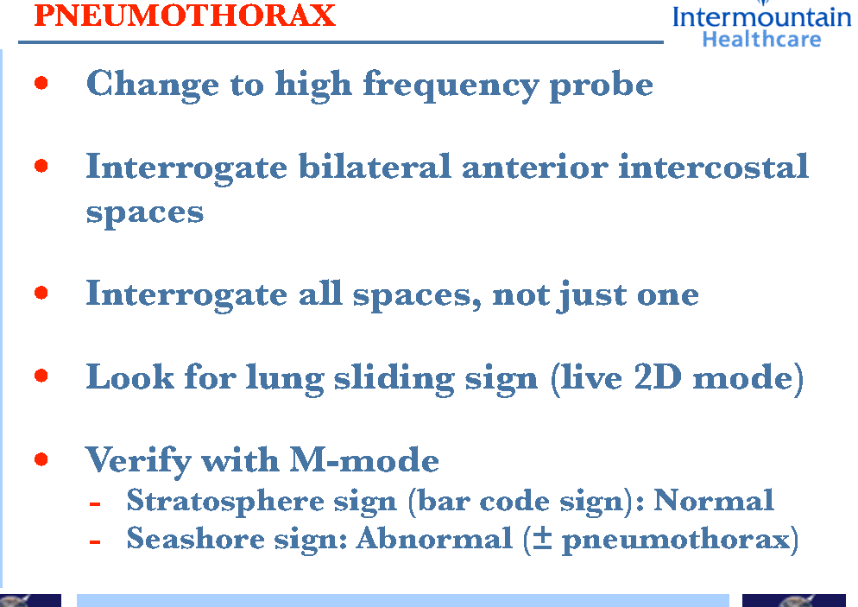

Slide 39
